Slide 1

AI-Powered Mental Health Diagnosis System

Slide 2



Mental Health Challenges: A Growing Crisis
Global Prevalence
Need for Swift Diagnosis
Limitations of Traditional Methods
Millions worldwide experience mental health disorders, significantly impacting their lives, relationships, and overall well-being. The sheer scale demands innovative solutions to meet the growing need for mental healthcare.
Rapid and accurate diagnosis is crucial for effective treatment and improved patient outcomes. Early identification minimizes suffering and enhances therapeutic effectiveness.
Current diagnostic methods often rely on subjective assessments and lengthy processes, causing treatment delays and potentially hindering recovery. More efficient and accurate approaches are needed.

Slide 3

Current Limitations of Traditional Diagnosis Methods
Subjectivity
Bias
Diagnosis relies heavily on subjective reports.
Potential for human bias in interpretation.
Inconsistency
Variability in diagnostic accuracy across clinicians.

Slide 4

Introducing AI: Transforming Mental Health Care
Enhanced Accuracy
Personalized Care
Objective analysis of data improves diagnosis.
Tailored insights for individual patients.
Increased Efficiency
Streamlined workflow reduces wait times.

Slide 5
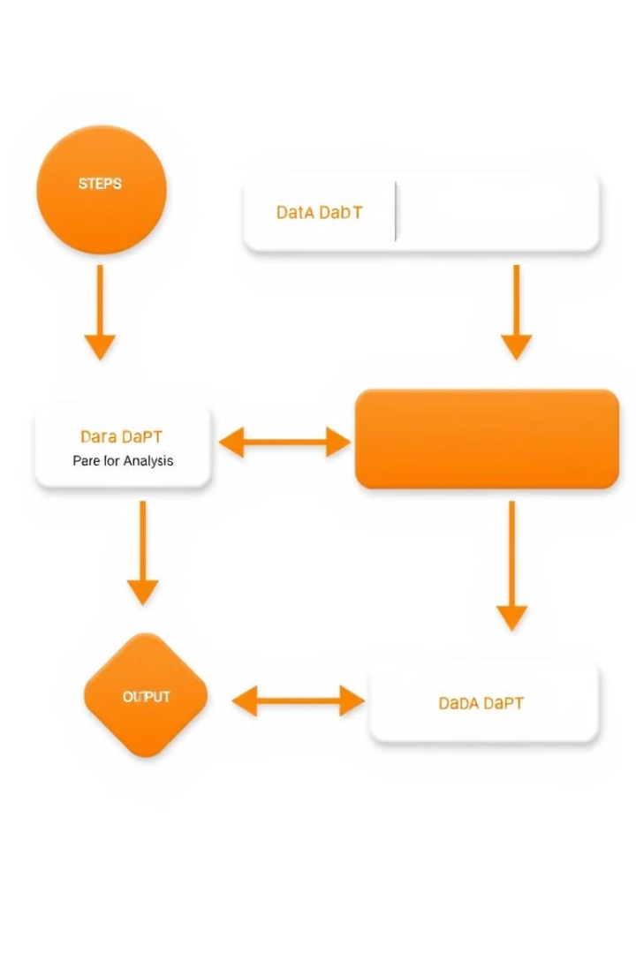
AI-Powered Diagnostic Process: How It Works
1
Collect patient data through surveys and assessments.
2
AI analyzes data using machine learning algorithms.
3
Generate a diagnostic report with potential conditions.
4
Clinicians review and interpret AI findings.

Slide 6




Improved Accuracy and Efficiency
Reduced Errors
Minimizes human bias and inconsistencies.
Faster Diagnosis
Streamlines the diagnostic process.
Improved Outcomes
Early intervention leads to better treatment.

Slide 7




Ethical Considerations and Data Privacy
Data Security
Protecting patient data is paramount.
Transparency
Clear communication about AI usage.
Fairness
Minimizing bias and ensuring equitable access.

Slide 8




Integrating AI into Clinical Practice
1
Pilot Programs
Training and Education
2
Prepare clinicians to use AI tools.
Ethical Review and Oversight
3
Establish robust governance structures.
Full Integration
4
AI becomes an essential component of mental health care.

Slide 9
The Future of Mental Health Diagnosis: Opportunities and Roadmap
1
Personalized Treatments
Early Intervention
2
Preventative measures and proactive care.
Improved Outcomes
3
Better patient well-being and quality of life.

